Slide 1

AWS to GCP Migration
Kene Igweagu
March 29, 2021
Notes:
Without further ado, let me present to you my plan to move from AWS to google cloud platform

Slide 2
AWS to GCP Migration
Your organization has implemented Google Workspace (Formerly G Suite) for email, enterprise collaboration, and cloud communications. The next step to take full advantage of your Google Workspace engagement is to move your applications to the Google Cloud Platform.
Kene Igweagu
March 29, 2021
Notes:
Your organization has implemented Google Workspace (Formerly G Suite) for email, enterprise collaboration, and cloud communications. The next step to take full advantage of your Google Workspace engagement is to move your applications to the Google Cloud Platform.

Slide 3
AWS to GCP Migration
Activity | Date of completion
Sponsorship and resources approved | Fri May 07
Concept approved | Mon May 17
Planning complete | Mon May 24
Kick-Off | Mon May 31
Design approved | Wed Jun 02
Development complete | Fri Jun 18
Go decision from pilot | Thu Jul 08
Deployed to production | Wed Jul 21
Post implementation review | Fri Jul 23
Kickoff maintenance teamwork | Tue Jul 27
Project end | Tue Jul 27
Kene Igweagu
March 29, 2021
The project will cost about $4692.97 over 3 months transferring data between our platforms and testing
Notes:
The project will cost about $5000 over 3 months transferring data between our platforms and running tests

Slide 4
AWS to GCP Migration
Pricing model | AWS | GCP
Cloud CDN | $30,510 | $24,548.20
File Storage | $1,627.60 | $451.00
Cloud DNS | $412.00 | $404.80
Proxy | $45.34 | $100.76
Load balancer | $426.03 | $427.85
Redis Cache | $45.34 | $51.84
Application Servers | $45.34 | $51.84
Elasticsearch Cluster | $346.10 | $580.73
Mongo DB | $346.10 | $580.73
PostgreSQL | $9,200.44 | $9,699.60
Message Queue | $912 | $2,047.60
3rd party API workers | $45.34 | $51.84
Cron schedule broker | $45.34 | $51.84
Total estimated monthly cost | $44,006.97 | $39,048.63
Google Cloud Platform
Better managed services
Reduced underlying infrastructure
Competitively priced communications
Smaller component deployments
User friendly for less tech-savvy users
Kene Igweagu
March 29, 2021
Notes:
Google Cloud Platform offers:
Better managed services
Reduced underlying infrastructure
Competitively priced
It’s generally better for smaller component deployments like yours
And the user friendly UI will be easier for less tech-savvy users in your organization
If you look at the total estimated monthly cost for running in both environments, you create significant cost saving by moving your architecture to GCP

Slide 5
The Challenge
For our migration approach, we want to complete our transition without any downtown or loss of data
Notes:
There's certain activities we have to complete for this project...
We'll have to Identify security and compliance requirements
Set up a Google Cloud account, organization, and infrastructure project
Create cloud source repositories
Identify requirements for connectivity: So,
How the VPC in both environments are set up,
Configuring a VPN between the subnets
If you’d like to see all of that, I’ve outlined all the admin stuff in the detailed project plan I provided.
For this presentation, I will focus on our migration approach, and the phases and activities involved there.
For our migration approach, we want to complete our transition without any downtown or loss of data.

Slide 6
Migrate for Compute Engine
Migrate for Compute Engine allows us to migrate VMs from AWS to GCP
Migrate for Compute Engine will move the entire state of the VM including the data
Notes:
Migrate for Compute Engine allows us to migrate VMs from AWS to GCP
Migrate for Compute Engine will move the entire state of the VM including the data

Slide 7
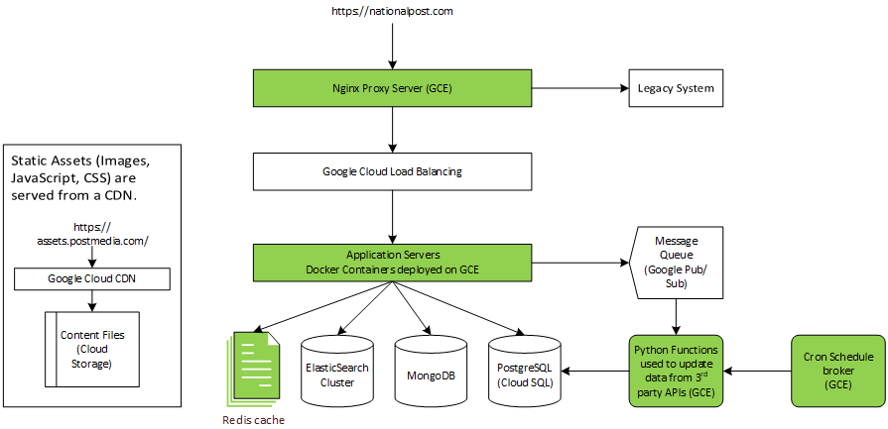
The Challenge
Notes:
So, if we look at the architecture, essentially everything that runs on a EC2 instance can be moved using migrate for compute engine.
This includes our Nginx proxy, application servers, cron based worker, cron schedule broker, and redis page cache.
If we ran into problems with applications running on google during our migration, that could lead to downtime so, we're breaking the migration into phases.
At the same time, moving at least one of these services to Google whilst the others remain in AWS would cause latency as requests would need to traverse the VPN.
Yet, our database is one of the biggest costs we have in our infrastructure, so we want to make sure that we are not running large replicas of the databases side by side for too long.

Slide 8

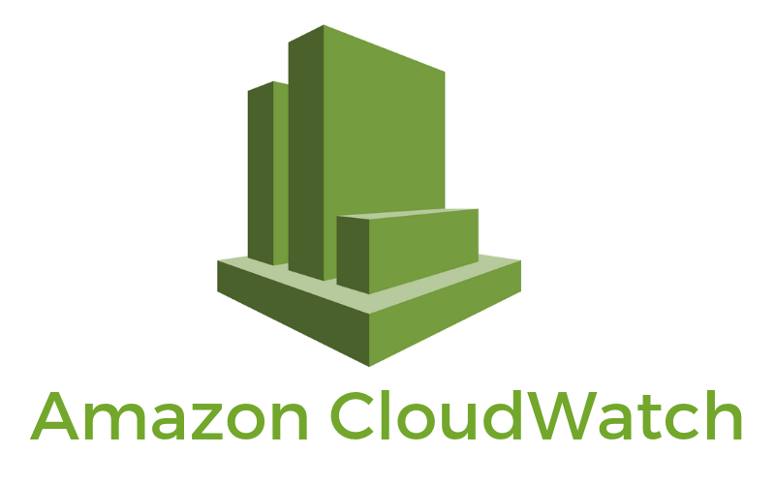
Baselines
Category | KPIs
User experience | Page load time
 | Lag
 | Response time
Application performance | Error rates
 | Throughput
 | Availability
 | Apdex (Application Performance Index)
Infrastructure | CPU usage %
 | Disk performance
 | Memory usage
 | Network throughput
Notes:
The first thing we want to do is to establish baselines for the performance of our applications.
These KPIs will determine if the performance of GCP is acceptable and inform the success of our project.
Amazon CloudWatch will help us to collect metrics on the peak, normal, and quiet time performance of our applications.
Later in the project we will compare these to the numbers we see in the Blue Medora dashboard for GCP.

Slide 9
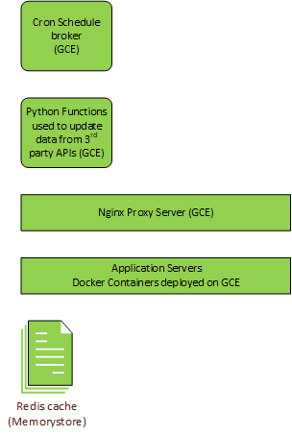
AWS to GCP Migration
Copy over EC2 clones
Cloned image
Tag and bag
Reconfiguration package
Full migration
Detach
Notes:
After scoping, planning, and securing the necessary approvals and resources, we kick off our project with the first stage of our migration.
Which will involve moving those EC2 instances that I mentioned from AWS to GCP.
It is important to note that when you run what is called a 'Full migration' lifecycle in the migration manager, it stops the VM in AWS and copies it over.
We don't want to stop our running VMs in AWS. We want our VMs in AWS to continue serving users while we go through the phases of our migration.
So, we will take an image of each of those EC2 instances and create cloned instances that we intend to migrate.
We can then create tags for identifying the clones that we want to migrate.
There is a Migrate for Compute linux package for reconfiguring the VMs for google cloud.
We want to turn off the instances so that we're not using up unnecessary resources.
If you look up Migrate for Compute Engine you'll find that alternatively, we could run what is called a test clone for our migration, but I don't think you can detach a test clone from the Migrate for Compute Engine cache. We also don't want to make any changes that would be written back to AWS. And of course, our approach is to run both environments using weighted records in Route 53 so, we will never want to run a full migration of the AWS server.

Slide 10
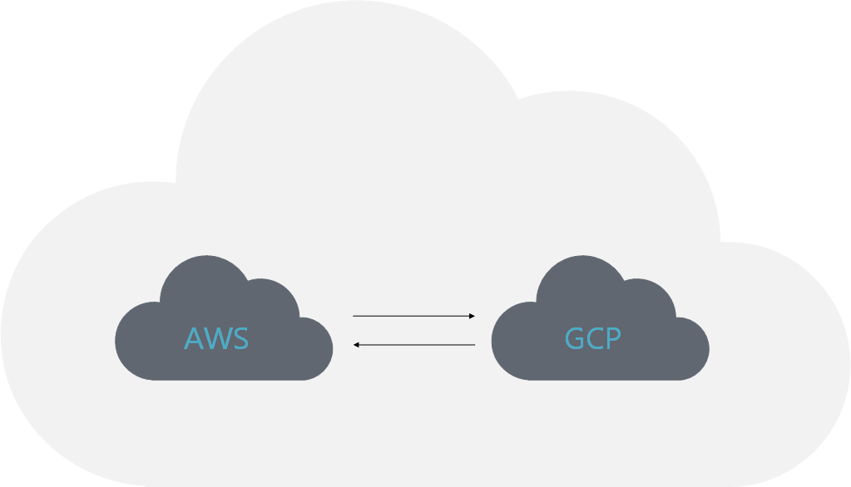
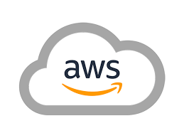

AWS to GCP Migration
Cross-platform communication
VPN network
Firewall rules
IAM user account
IAM group
Notes:
We need to configure necessary VPN permissions in AWS to allow communication between our platforms.
So, we set up network, access, and firewall rules to allow communication to our migration environment from AWS.
There's a CloudFormation template we will use to configure the Migrate for Compute Engine IAM group in AWS.
And we create the AWS IAM user account for Migrate for Compute Engine with programmatic access and download the AWS IAM user CSV with the access keys and store it securely.

Slide 11

AWS to GCP Migration
GCP Environment
Google cloud VPC
IAM user account, roles, and service accounts
migration manager and migration manager passwords
Allow https for the Migrate for Compute Engine Manager
Configure logging from Migrate for Compute Engine Manager
AWS as a Migrate for Compute Engine source
Set up Cloud Extensions in Migrate for Compute Engine Manager for our VMs
Notes:
In our GCP environment:
We set up a Google cloud VPC
Create Google Cloud roles and service accounts via Cloud Shell
Create the IAM user account for Migrate for Compute Engine with the necessary roles and privileges
Create and configure the migration manager and migration manager passwords
Allow https for the Migrate for Compute Engine Manager instance
Configure logging from Migrate for Compute Engine Manager
Configure AWS as a Migrate for Compute Engine source
Configure GCP Compute Engine API quotas to allow the needed size persistent disk
Set up Cloud Extensions in Migrate for Compute Engine Manager for our VMs.
Each Cloud Extension supports up to 20 or up to 50 concurrent VMs so we should only need the 1

Slide 12
AWS to GCP Migration
Copy over EC2 clones
Create runbook
Edit runbook CSV
Load and validate wave
Create and run a Full migration job
Create and run the Detach job
Notes:
We will copy over nginx, application servers, workers, cron schedule broker, and redis page cache:
To do that we create a runbook
Edit the runbook CSV to only include the server clones
Load the runbook CSV into a new wave
Validate the wave
Create and start a Full migration job for the wave
And then we create and run the Detach job for the wave

Slide 13
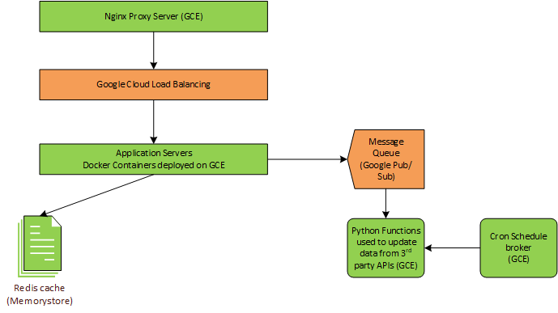
AWS to GCP Migration
Dev environment
Connect to Redis
Autoscaling load balancing
Configure pub/sub queue
Unit and Integration tests
Notes:
With our instances copied over our next step is to configure the load balancer and pub/sub queue
Whether our application servers were configured to use the AWS service registry or specific URLs, our VPC and VPN settings should not allow the instances to be writing to our live databases
Google allows service discovery which makes it easier when we deploy from our dev to staging to prod environments
So, we will configure all our copied over VMs to register as the type of service and to connect to the type of service that they are integrated with in our architecture
So, you want to connect to the Redis instance from the Compute Engine VMs using redis-cli
Configure internal http load balancing with autoscaling from proxy server to application servers
You, configure a pub/sub queue topic with the cron based worker service as the subscribers
The pub/sub queue needs a pub/sub service account with pub/sub publisher and subscriber roles
We install the Cloud SDK and python environments on the application servers and the worker instances
And the we start the subscriber python applications on the workers and the publisher python applications on the application servers
For Unit testing our applications, we will use mockers. We will:
Develop integration tests for application server integrations
Develop integration tests for cron based worker integrations, and
Run the full suite of integration tests to test component integration
Once that is done, we have completed the dev stage

Slide 14
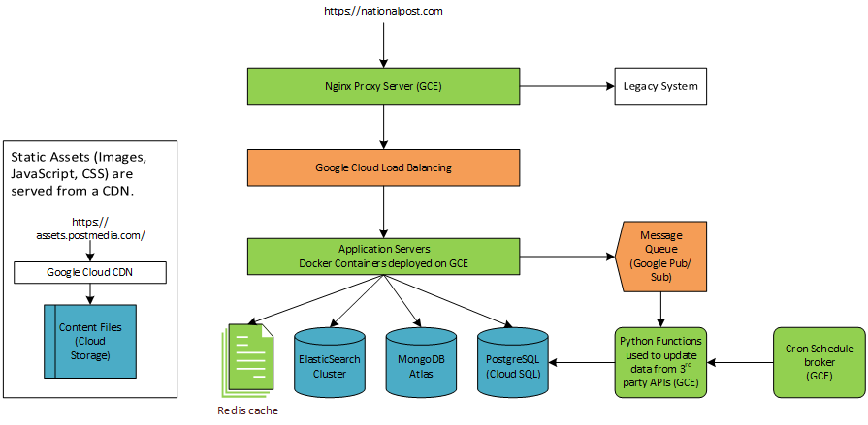
AWS to GCP Migration
Staging
Import dev resources
Create storage bucket
Restore databases from dumps
Run pilot
Transfer S3 bucket to cloud storage
Notes:
In our staging phase, we want to run a pilot of what it will be like to run our applications in GCP
In this stage we will need the database services for our pilot
You import dev resources to staging environment using terraform
Create a bucket in your Google Cloud project, this is where we will keep the binaries for our database snapshots

Slide 15

AWS to GCP Migration
mongo DB
Configure MongoDB Atlas in GCP
mongodump from AWS
copy the binary to GCP storage
mongorestore in GCP
register MongoDB service
Notes:
We will need to configure MongoDB Atlas in GCP
Run mongodump in AWS to get a backup file of the entire database
copy the binary to GCP storage
mongorestore in GCP
And register MongoDB service

Slide 16

AWS to GCP Migration
PostgreSQL
Set up PostgreSQL in Google Cloud
Take a full backup from the running master server using pg_dump
Transfer the backup to the GCP bucket
pg_restore the backup file into the Google Cloud master
Register the PostgreSQL service
Notes:
We will need to set up PostgreSQL in Google Cloud
Take a full backup from the running master server using pg_dump
Transfer the backup to the GCP bucket
pg_restore the backup file into the Google Cloud master
And Register the PostgreSQL service

Slide 17

AWS to GCP Migration
Elasticsearch cluster
Create a new Elasticsearch cluster deployment
Allow TCP traffic on port 9243
register GCP cloud storage bucket as a snapshot repository
Verify the repository
Create a snapshot from AWS
Restore the snapshot in the GCP cluster
Register the Elasticsearch service
Notes:
We will create a new Elasticsearch cluster deployment
Allow TCP traffic on port 9243 for reindexing the new deployment
register our GCP cloud storage bucket as a snapshot repository
Verify the repository
Create a snapshot from AWS
Restore the snapshot in the GCP cluster
And Register the Elasticsearch service

Slide 18
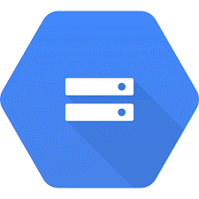
AWS to GCP Migration
Google Cloud Storage
Create an AWS IAM transfer user with the ability to perform the necessary transfer actions
Create at least one access/secret key pair for the transfer job
Create GCP Cloud storage bucket and make your Cloud Storage bucket public
Create the external HTTP(S) load balancer and Reserve an external IP address
Set up the transfer job on the transfer page to run
Register the storage service
Notes:
For our cloud storage we will create an AWS IAM transfer user with the ability to perform the necessary transfer actions
Create at least one access/secret key pair for the transfer job
Restore any objects that are archived to Amazon Glacier
Create a GCP Cloud storage bucket
Make your Cloud Storage bucket public
Reserve an external IP address
Create the external HTTP(S) load balancer
Set up the transfer job on the transfer page to run
And Register the storage service

Slide 19
Staging
Connect to all services
Develop integration tests
Develop end-to-end tests
Run full test suite
Modify and retest
AWS to GCP Migration
Notes:
Configure your application server to connect to all these services
Develop integration tests for MongoDB, PostgreSQL, and the Elasticsearch cluster
Test resolving cloud storage files
Run the full suite of integration tests to test component integration
Identify anomalies
Modify our configurations
And Re-test the modified implementation
Similarly, we will develop end-to-end tests and test plans based on our architecture specifications
Run end-to-end scenarios
Identify anomalies
Modify our configurations
And Re-test the modified implementation

Slide 20

AWS to GCP Migration
Pilot
Identify test group
Test all identified scenarios
Obtain user feedback
Evaluate performance and functionality
Make necessary changes to the code based on evaluation
Notes:
Now we can run a pilot
We will Identify a test group
Configure environment to allow user interaction for testing
And Start running staging environment
We will Perform pilot and test all our identified scenarios
Obtain user feedback
Evaluate performance and functionality
And Make necessary changes to the code based on our evaluation

Slide 21

AWS to GCP Migration
Production
Deploy staging resources to production using terraform
Allow data replication through the VPN
Setup Postgres SQL as a SLAVE then promote to MASTER
Add mongoDB as a replica set then give voting rights to GCP
Reindex Elasticsearch cluster
Notes:
With staging completed and approvals for a go-decision obtained, we are ready to go to production
To go to production, we will import the staging environment to the Prod environment, replicate our databases, and configure weighted routing to run both environments in parallel before a final changeover window.
So we, import staging resources into terraform
create cloud deployment manager for deploying resources to the production environment
deploy resources to the production environment
And Allow data replication through VPN
We set up PostgreSQL replication with AWS as the MASTER and GCP as the SLAVE
When data replication is completed, we promote GCP to the MASTER

Slide 22
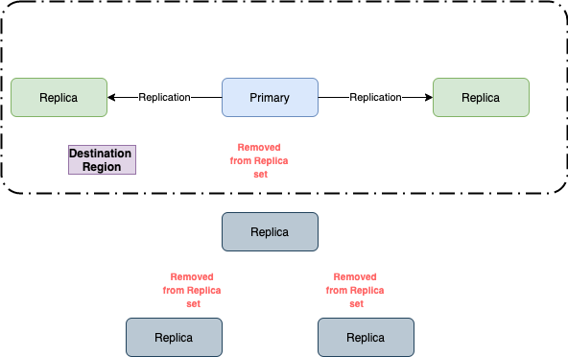
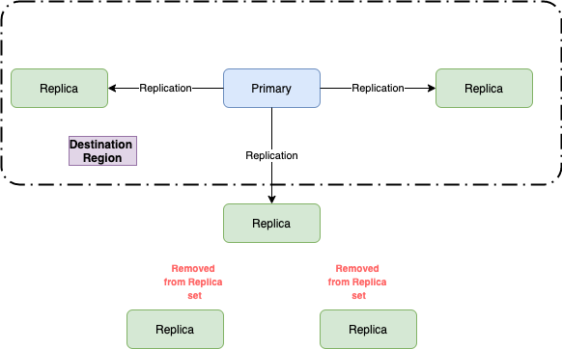
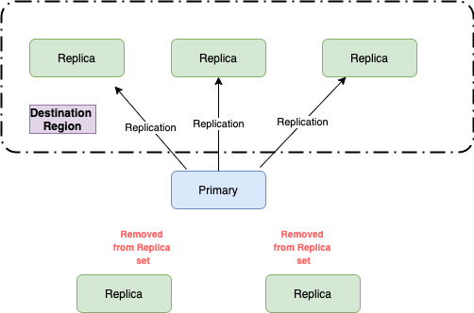
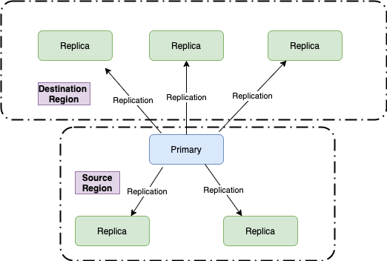
AWS to GCP Migration
Notes:
For mongoDB, we launch the same number of source instances as the AWS MongoDB replica set
Update bindIp of new launch instances to use the private Ip of our instance and restart new mongo instances
Login to the primary AWS instance and add all GCP instances as a replica and wait until stateString becomes SECONDARY state for all GCP instances
We Update the route53 host to point to GCP
redeploy all mongodb clients to refresh DNS entries in case of any caching
set GCP replicas priority higher than AWS and give voting rights to GCP replicas
Remove the AWS replicas from the set
Initiate leader election and step down the old AWS primary
Then we Remove the final AWS instance from the set

Slide 23
AWS to GCP Migration
Production
Deploy staging resources to production using terraform
Allow data replication through the VPN
Setup Postgres SQL as a SLAVE then promote to MASTER
Add mongoDB as a replica set then give voting rights to GCP
Reindex Elasticsearch cluster
Notes:
We will reindex our ElasticSearch cluster
To do this we Add the reindex.remote.whitelist user setting to the AWS Elasticsearch cluster
Allow TCP traffic on port 9243
From the API Console create the destination index on Elasticsearch Service
Copy the index from the remote cluster
When the reindex job completes, we set the refresh_interval and number_of_replicas to the desired values
Once reindexing is complete and the status of the new index is green, you can delete the old index
You should run the test suite in production for sanity check
Then we can set up a 50/50 weighted DNS in Route53 for both platforms
We will create a GCP managed zone
Export the DNS configuration from AWS
And Import the record set in GCP
Verify DNS propagation
And Update our registrar's name server records
We should now complete post go-live validation and remove managed zones in AWS

Slide 24

AWS to GCP Migration
Post Implementation Review
Get acceptance of deliverables
Evaluate stakeholder satisfaction
Review project goals, timeline, budget, success metrics, and major events
Document what worked and what can be improved for future projects
Distribute to team members
Notes:
As part of our post implementation review,
We Get acceptance of deliverables
Evaluate stakeholder satisfaction
Review project goals, timeline, budget, success metrics, and major events
Discuss what worked and what can be improved for future projects
Document lessons learned and create an action plan to address feedback
We Distribute all documentation to team members

Slide 25
AWS to GCP Migration
Handover to business and maintenance team
Reassign resources
Identify key roles and responsibilities for maintenance
Provide supporting documentation
Walk the team through the day to day of the maintenance
Kickoff maintenance teamwork
Reconfigure weighted DNS to GCP only
Decommission AWS resources
Notes:
Finally, in handing over to the business teams
You reassign resources
Identify key roles and responsibilities for maintenance
Provide supporting documentation
Walk the team through the day to day of the maintenance
Kickoff maintenance teamwork
Reconfigure weighted DNS to GCP only
And Decommission AWS resources

Slide 26
AWS to GCP Migration
Thank you
Kene Igweagu
March 29, 2021
Notes:
Thank you for listening
I’ll now be taking any questions you might have

